Slide 1
CTL Model Checking
Wishnu Prasetya
wishnu@cs.uu.nl
www.cs.uu.nl/docs/vakken/pv

Slide 2
Background
Example: verification of web applications → e.g. to prove existence of a path from page A to page B.
Use of CTL is popular → another variant of “temporal logic” → different way of model checking.
Model checker for verifying CTL: SMV. Also uses a technique called “symbolic” model checking.
  In contrast, SPIN model checking is called “explicit state”.
  We’ll show you how this symbolic MC works, but first we’ll take a look at CTL, and the web application case study.

Slide 3
Overview
CTL
  CTL
  Model checking
Symbolic model checking
BDD
  Definition
  Reducing BDD
  Operations on BDD
Acknowledgement: some slides are taken and adapted from various presentations by Randal Bryant (CMU), Marsha Chechik (Toronto)

Slide 4
CTL
Stands for Computation Tree Logic
Consider this Kripke structure (labeling omitted) :
In LTL, an “execution” is defined as a sequence :
0
1
2
2
2
. . .
M :
0
0
0
0
1
2
. . .
2
In CTL an execution is viewed as a tree :
0
1
0
1
0
1
2
. . .
2
2

Slide 5
CTL
Informally, CTL is interpreted over computation trees.
M |== ϕ = M’s computation trees satisfies ϕ
We have path quantifiers :
  A ... : holds for all path (starting at the tree’s root)
  E ... : holds for some path
Temporal operators :
  X ... : holds next time
  F ... : holds in the future
  G ... : always hold
  U : until
Notes:
M would only have one computation tree if it only has 1x innitial states; else it can have multiple comp. trees. Of course, each computation tree can be inifitely deep.

Slide 6
Intuition of CTL operators
EX (exists next) ϕ
AX (all next) ϕ
ϕ
ϕ
ϕ
EG ϕ
AG ϕ
ϕ
ϕ
ϕ
ϕ
ϕ
ϕ
ϕ
ϕ
ϕ
ϕ
ϕ
ϕ
ϕ
ϕ
ϕ

Slide 7
Intuition of CTL operators
EF ϕ
AF ϕ
ϕ
ϕ
ϕ
ϕ
ϕ
E[ ψ U ϕ ]
A[ ψ U ϕ ]
ψ
ψ
ψ
ϕ
ψ
ϕ
ψ
ϕ
ϕ

Slide 8
Syntax
ϕ ::= p // atomic (state) proposition
| ¬ϕ | ϕ₁ /\ ϕ₂
| EX ϕ | AX ϕ
| E[ϕ₁ U ϕ₂] | A[ϕ₁ U ϕ₂]

Slide 9
Derived operators
ψ \/ ϕ = ¬(¬ϕ /\ ¬ψ)
ψ → ϕ = ¬ψ \/ ϕ
EF ϕ = E[ true U ϕ ]
AF ϕ = A[ true U ϕ ]
EG ϕ = ¬ AF ¬ϕ
AG ϕ = ¬ EF ¬ϕ

Slide 10

Semantics
R : S → {S} : transition relation
V : S → {Prop} : observations
Let M = ( S, s₀, R, V ) be a Kripke structure ☺
M,t |== ϕ ϕ holds on the comp. tree t
M |== ϕ is defined as M, tree(s₀) |== ϕ
M,t |== p = p ∈ V(root(t))
M,t |== ¬ϕ = not ( M,t |== ϕ )
M,t |== ϕ/\ψ = M,t |== ϕ and M,t |== ψ

Slide 11
Semantic of “X”
M,t |== EXϕ = ( ∃v∈ R(root(t)) :: M,tree(v) |== ϕ )
M,t |== AXϕ = ( ∀v∈ R(root(t)) :: M,tree(v) |== ϕ )
This definition of the A-quantifier is a bit problematic if you have a terminal state t (state with no successor), because then you get t |== AX ϕ for free, for any ϕ (the above ∀-quantification would quantify over an empty domain). This can be patched; but we’ll just assume that your M contains no terminal state (all executions are infinite).

Slide 12
Semantic of “U”
M,t |- E[ ψ U ϕ ] =
There is a path σ in M, starting in root(t) such that:
  For some i≥0, M,tree(σ_{i}) |== ϕ
  For all previous j, 0≤j<i, M,tree(σ_{j}) |== ψ
M,s |- A[ ψ U ϕ ] =
For all path σ in M, starting in root(t), these hold:

Slide 13
LTL vs CTL
They are not the same.
Some properties can be expressed in both:
AG (x=0) = [] (x=0)
AF (x=0) = <>(x=0)
A[x=0 U y=0] = x=0 U y=0
Some CTL properties can’t be expressed in LTL, e.g:
EF (x = 0)
Prop = { x= 0 }
∅
{x=0}

Slide 14





LTL vs CTL
Some LTL properties cannot be expressed in CTL, e.g.
<>[] p
E.g. AF AG p does not express the property; the above Kripke does not satisfy it.
{p}
∅
{p}
Prop = { p }

Slide 15




LTL vs CTL
Another example, fairness restriction:
([]<> p → <>q) → <>q
= []<>p \/ <>q
∅
e.g. AGAF p \/ AF q does not hold on the tree.
{p}
{q}
Notes:
(a -> b) -> b = ~((~a \/ b)) \/ b = (a /\ ~b) \/ b = a \/ b

Slide 16

CTL*
Allows more combinations of path and temporal quantifiers.
A CTL* formula is a “state formula”, syntax:
(State formula)
ϕ :: p // p is atomic proposition
| ¬ϕ | ϕ₁ \/ ϕ₂
| E f | A f // f is a path formula
(Path formula)
f :: ϕ
| ¬f | f \/ g | Xf | Ff | Gf | f₁ U f₂
We can express all CTL formulas in CTL*, but e.g. this is also possible in CTL* :
AFG (x=0)

Slide 17
Example: web application
Based on:
A Model Checking-based Method for Verifying Web Application Design, Donini et al, in Int. Workshop on Web Lang. and Formal Methods (WLFM), 2005.
In their approach, models are obtained from UML design of the web application.
Other possibilities:
  By crawling a web site
  By analyzing log

Slide 18

WAG
Model web application as a graph (N,C), where
N = W ∪ P ∪ L ∪ A
each component is disjoint.
C : N→2^{N} defines the arrows in the graph, and such that:
  A window can only be connected to pages
  A page can only be connected to links or actions
  A link or an action can only be connected to windows
Called “Web Application Graph” (WAG)
W set of windows
P set of pages
L set of links
A set of actions

Slide 19
WAG as Kripke
See a WAG as a Kripke structure, e.g. each node in the WAG is a state in the Kripke structure.
Label each state with propositions w,p,l,a to express whether it is a window, or a page etc.
Introduce other propositions of interest, e.g.
  login, logout To mark a login/logout action
  private To mark states considered “private”
  error To mark “error page”.
Label the states with these propositions.

Slide 20
Example
{ loginSuccess }
{ private }
…
frame/window
page
action
link

Slide 21
Now properties like these are well defined…
A (¬private W ¬private /\ loginSuccess)
You cannot get to the private part without logging in….
AG ( loginSucess → EF private )
Once logged in, it should be possible to get to the private part

Slide 22
Model checking CTL formulas
Kripke M = ( S, s₀, R, V )
We want to verify M |== ϕ
Assume ϕ is expressed in CTL’s (chosen) basic operators.
The verification algorithm works by systematically labeling M’s states with subformulas of ϕ.
After the labeling:
{ p }
{ p }
0
1
2
3
{ p,q }
∅
Whenever we conclude root(s) |= f , we label s with f.
M |= ϕ iff s₀ is labeled with ϕ

Slide 23
Example, checking EX(p/\q)
Prop = {p,q}
{ p }
{ p }
Initial state is not labeled with the target formula; so the formula is not valid.
0
1
EX(p/\q)
2
3
{ p,q }
∅
p /\ q
EX(p/\q)

Slide 24

Example, checking A[ p U (p/\q) ]
{ p }
{ p }
A[ p U p/\q]
At the end, initial state is not labeled with the target formula; so the formula is not valid
0
1
2
3
{ p,q }
∅
p /\ q
A[ p U p/\q]

Slide 25
Example, checking: E[ p U (p/\q) ]
E[ p U p/\q]
{ p }
{ p }
E[ p U p/\q]
0
1
Initial state is labeled with the target formula; so M satisfies the formula.
2
3
{ p,q }
∅
p /\ q
E[ p U p/\q]

Slide 26
Can we apply this to LTL ?
Consider <>[] p = <>¬<>¬p
Applying labeling :
Prop = { p }
{p}
∅
{p}
¬<>¬p … ??
<>¬p
¬<>¬p … ok
When you cant label a state with ϕ, for LTL this does not imply that ¬ϕ is valid on all executions starting from that state. It worked in CTL because ¬AF¬p = EG p … where as what we want is []p, which corresponds to AG p.

Slide 27
Symbolic representation
You need the full statespace to do the labeling!
Idea:
  Use formulas to encode sets of states (e.g. to express the set of states labeled by something)
  A small formula can express a large set of states → suggest a potential of space reduction.

Slide 28

Example
{ p }
{ p }
E.g. the set of states where q holds is encoded by the formula:
x¬y
Similarly, the set of states where p holds : {0,1,2}, can be encoded by formula:
¬(xy)
0
1
2
3
{ p,q }
∅
4 states, can be encoded by 2 boolean variables x and y.
St-0 ¬x¬y
St-1 ¬xy
St-2 x¬y
St-3 xy

Slide 29


Example
We can also describe this more program-like:
if state∈{0,2} → goto {0,1}
[] state∈{1,3} → goto 2
[] state=3 → goto {2,3}
fi
which can be encoded with this boolean formula:
{ p }
{ p }
0
1
¬xy
¬x¬y
N.D.
x¬y
2
3
xy
{ p,q }
∅
States encoding:
St-0 ¬x¬y
St-1 ¬xy
St-2 x¬y
St-3 xy
¬y¬x’ \/ yx’¬y’ \/ xyx’

Slide 30

Example
byte x ; // unspecified initial value
if x≠255 → x=0 ;
The automaton has 256 states, with 256 arrows.
Bit matrix : 8.3 Kbyte
List of arrows: 512 bytes
¬(x₀..x₇) /\ ¬x’₀... ¬x’₇
\/
x₀...x₇ /\ x’₀... x’₇
With boolean formula:

Slide 31

Model checking
When we label states with a formula f, we are basically calculating the set of states (of M) that satisfy f.
Introduce this notation:
W_{f} = the set of states (whose comp. trees) satisfy f
= { s | s∈S, M, tree(s) |== f }
We now encode W_{f} as as a boolean formula
M |= f if and only if W_{f} evaluated on s₀ returns true

Slide 32



Labeling
If p is an atomic formula:
For conjunction:
Negation:
For EX:
AX f = ¬EX¬f
W_{p} = boolean formula representing the set of states where p holds.
W_{f/\g} = W_{f} /\ W_{g}
W¬_{f} = ¬W_{f}
W_{EXf} = ∃x’,y’:: R /\ W_{f} [x’,y’/x,y]
Notes:
NOTE: The relation R is assumed to be defined in terms of x,y and x’,y’

Slide 33



On filtering arrows…
States encoding:
St-0 ¬x¬y
St-1 ¬xy
St-2 x¬y
St-3 xy
{1,3} → {2}
Suppose we have these arrows, R =
{3} → {1,3}
y x’¬y’ \/ xyy’
To filter arrows over destinations, conjunct it with a formula f over primed vars, e.g to get arrows that end up in state 1 :
( y x’¬y’ \/ xyy’ ) /\ ¬x’y’
To get only the source-states, quantify over primed vars, e.g. :
∃x’,y’ :: ( y x’¬y’ \/ xyy’ ) /\ ¬x’y’
Notes:
In comparison, in set notation it would something like :
{ v | (Exists w :: v→w in R) }

Slide 34

Filtering 2
(∀x’,y’ :: R(x,y,x’,y’) ⇒ W(x’,y’))
Would give the set of source-states whose outgoing arrows all go to W.
Note:
this would include all terminal states in M … weird, but we discussed this before. We assumed M does not contain terminals.
this would include all invalid encodings (those states that were not actually in your M) as well → add a constraint that filters your result to drop those states.

Slide 35

Example, EXp
{ p }
{ p }
0
1
¬xy
W_{p} = ¬(xy)
W_{EXp} = ∃x’,y’:: R /\ ¬(x’y’)
= ∃x’,y’:: ((¬y¬x’ \/ yx’¬y’ \/ xyx’) /\ ¬(x’y’))
= true
¬x¬y
x¬y
2
3
xy
{ p,q }
∅
States encoding:
St-0 ¬x¬y
St-1 ¬xy
St-2 x¬y
St-3 xy
Notes:
R = ¬x(¬y¬x’ \/ yx’¬y’)
\/
x(¬y¬x’ \/ yx’)

Slide 36
Labeling
E.g. the states satisfying E[f U g] can be computed by:
  Let K₀ = W_{g}
  Iteratively compute K_{i}
  Stop when K_{i+1} = K_{i} ; then W_{E[p U q]} = K_{i}
K_{i+1} = K_{i} \/ ( ∃x’,y’:: R /\ W_{f} /\ K_{i} [x’,y’/x,y] )
Notes:
NOTE: The relation R is assumed to be defined in terms of x,y and x’,y’

Slide 37


Example, EX[ p U q ]
{ p }
{ p }
K₀ = W_{q} = x¬y
0
1
¬xy
¬x¬y
K₁ = K₀
\/
(∃x’,y’:: R /\ W_{p} /\ K₀[x’,y’/x,y])
x¬y
2
3
xy
{ p,q }
∅
x¬y \/ (∃x’,y’:: ... /\ ¬(xy) /\ x’¬y’)
States encoding:
St-0 ¬x¬y
St-1 ¬xy
St-2 x¬y
St-3 xy
K₂ = …
Till fix point.
Notes:
R = ¬x(¬y¬x’ \/ yx’¬y’)
\/
x(¬y¬x’ \/ yx’)
Furthermore we need Wp = ~(xy).

Slide 38
But how to check fix point?
To make this works, we need a way to efficiently check the equivalence of two boolean formulas:
f ↔ g
So, we can decide when to we have reached a fix-point
In general this is an NP-hard problem.
Use a SAT-solver to check if ¬(f ↔ g) is unsatisfiable.
We’ll discusss BDD approach

Slide 39
Canonical representation
= simplest/standard form.
Here, a canonical representation C_{f} of a formula f is a representation such that:
Gives us a way to check equivalence.
Only useful if the cost of constructing C_{f}, C_{g} + checking C_{f} = C_{g} is cheaper than directly checking f ↔ g.
Some possibilities:
  Truth table → exponentially large.
  DNF/CNF → can also be exponentially large.
f ↔ g iff C_{f} = C_{g}
Notes:
E.g. in DNF, ~(xy) has to be represented by ~xy \/ x~y \/ ~x~y .

Slide 40
BDD
Binary Decision Diagram; a compact, and canonical representation of a boolean formula.
Can be constructed and combined efficiently.
Invented by Bryant:
"Graph-Based Algorithms for Boolean Function Manipulation". Bryant, in IEEE Transactions on Computers, C-35(8),1986.

Slide 41
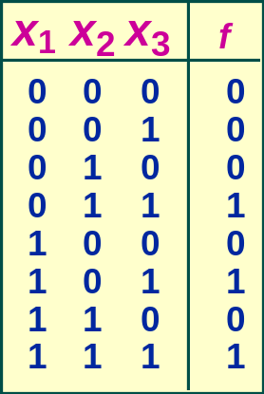
Decision Tree
¬x₁ x₂ x₃ \/ x₁ ¬ x₂ x₃ \/ x₁ x₂ x₃
with truth table :
Or representing the table with a (binary decision) tree :
x
1
x
2
x
2
x
3
x
3
x
3
x
3
0
0
0
1
0
1
0
1
TT is canonical if we fix the order of the columns.
  Each node x_{i} represents a decision:
    Blue out-edge from x_{i} → assigning 1 to x_{i}
    Red out-edge from x_{i} → assigning 0 to x_{i}
  Function value is determined by leaf value.

Slide 42
But we can compact the tree…
E.g. by merging the duplicate leaves:
x
x
1
1
x
x
x
2
x
2
2
2
x
x
x
x
x
3
x
3
x
3
x
3
3
3
3
3
0
0
0
1
0
1
0
1
0
1
We can compact this further by merging duplicate subgraphs …

Slide 43
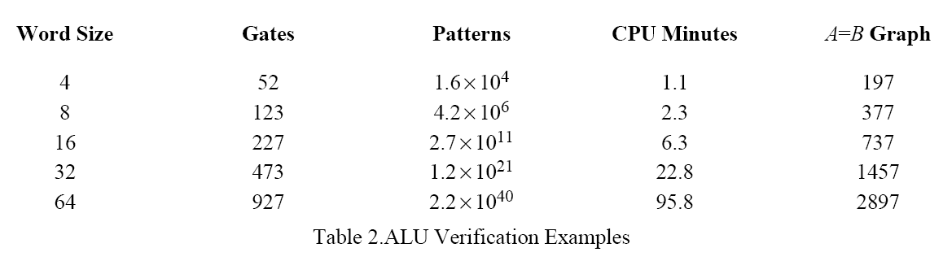
Results
Note: this is from Bryant’s paper in 1986. They use their version of MC at that time, running it on an DEC VAX 11/780, with about 1 MIP speed ☺
Notes:
“Gates” = the number of basic digital components (called gates) used to construct the ALU.
“Patterns” = the number of input-combinations for this ALU
“A=B graph” the size (#nodes) of the reduced-graph that corresponds to the ALU’s function for calculating if the inputs A are equal to inputs B.

Slide 44

Boolean formula
A boolean formula (proposition logic formula) e.g. x . y \/ z can be seen as a function :
In Bryant’s paper this is called a : boolean function.
E.g. ‘composing’ functions as in
“f(x, y, g(x,y,z))”
is the same as the corresponding substitution.
f(x,y,z) = x.y \/ z

Slide 45



Binary Decision Diagram
A BDD is a directed acyclic graph, with
  a single root
  two ‘leaves’ → 0/1
  non-leaf node
    labeled with ‘varname’
    has 2 children
Along every path, no var appears more than 1x
We’ll keep the arrow-heads implicit
  always from top to bottom
.
suppose we call this node: v
var(v)
x
low(v)
y
high(v)
z
0
w: 1
val(w)

Slide 46




func(G)
x = val(v)
func(v) = ¬x . func(low(v)) \/ x . f(high(v))
func(G) = func(root)
xz \/ ¬x.¬y.z
x
¬y.z
y
z
z
0
1
func(0) = 0, func(1) = 1
Notes:
You can also think a boolean function f(x,y,z) as a function that specifies all combinations of x,y,z such that this function gives a true. That is, it specifies the set:
{ (x,y,z) | f(x,y,z) = true }

Slide 47

Reduced BDD
Two BDDS F ang G are isomorphic if you can obtain G from F by renaming F’s nodes, vice versa.
But you are not allowed to rename var(v) nor val(v) !
A BDD G is reduced if:
  for any non-leaf node v, low(v) ≠ high(v).
  for any distinct nodes u and v, the sub-BDDs rooted at them are not isomorphic.
then: func(F) = func(G)
otherwise G can be reduced!

Slide 48
Ordered BDD
OBDD → fix an ordering on the variables
  let index(v) → the order of v in this ordering ☺
  index(v) < index(low(v)
  same with high(v)
.
y
z
z
satisfies ordering [y,z,x] but not [x,y,z]
x
0
1

Slide 49

Reduced OBDD
Reduced OBDD is canonical:
Same idea as in truth tables: canonical if you fix the order of the columns.
However, the chosen ordering may influence the size of the OBDD.
If we fix the variable ordering, every boolean function is uniquely represented by a reduced OBDD (up to isomorphism).

Slide 50
Effect of ordering
Consider:
xyz \/ ¬yz
x
y
y
z
z
z
x
0
1
0
1
Order: x,y,z
Order: y,z,x

Slide 51
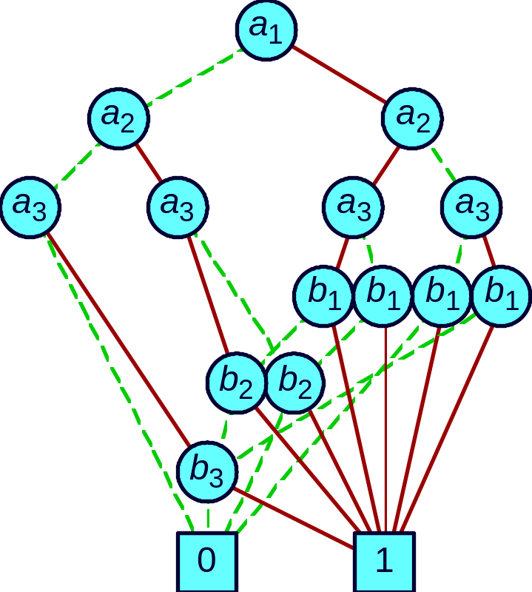
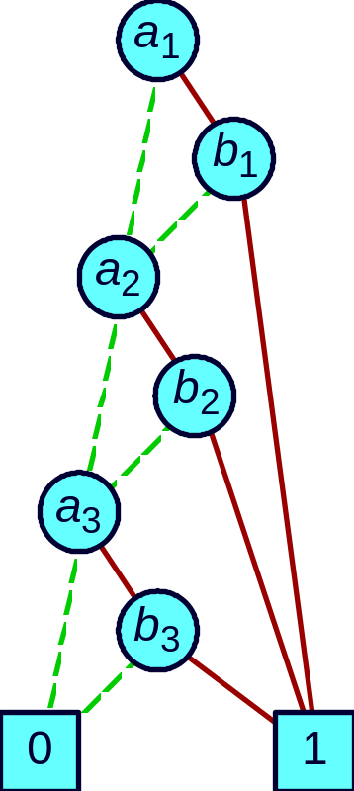
The difference can be huge…
consider: a₁b₁ \/ a₂b₂ \/ a₃b₃
Exponential Growth
Linear Growth
Here: “red” for value 1, “green” for 0.

Slide 52
Reducing BDD
x
x
y
y
y
y
z
z
z
z
z
z
z
z
0
0
0
1
0
1
0
1
0
1
By sharing leaves…

Slide 53








Reducing BDD
x
x
y
y
y
y
z
z
z
z
v
z
z
v
0
1
0
1
x
y
z
0
1

Slide 54

The reduction algorithm
Introduce id, function Node → Node
Use it to keep track which nodes actually represent the same formula.
Iterate/recurse and maintain this invariant:
So, we can remove u from the graph, and re-route arrows to it, to go to id(u) instead.
Work bottom up, and such that a node decorated with x is processed after all nodes whose decorations come later in the var-ordering are processed first.
func(u) = func(id(u))

Slide 55

The reduction algorithm
We’ll do the relabeling recursively, bottom-up.
Now suppose we have done the id re-labeling for all non-leaves w with index(w)>i. Suppose index(v)=i
  Case-1, id(low(v)) = id(high(v)) ; suppose var(v) = “x”
x
v
y
func(v) = ¬y . func(low(v)) \/ y . func(high(v))
= ¬y . func(id(low(v))) \/ y . func(id(high(v)))
= func(id(low(v))
y
z
0
1
So, update: id(v) := id(low(v))
Notes:
Note that we have “index” and we have “id” .

Slide 56

The reduction algorithm
  Case-2: there is another non-leaf u∈dom(id)
  (u has been processed) such that:
  1. var(u) = var(v) ; suppose this is “x”
  2. id(low(u)) = id(low(v))
  3. id(high(u)) = id(high(v))
u
v
x
x
id
id
func(v) = ¬x func(low(v)) \/ x func(high(v))
= ¬x func(low(u)) \/ x func(high(u)) // by inv
= func(u)
= func(id(u))
So, update: id(v) := id(u)
Notes:
Basically this is the case when the low-kids of u and v represent the same subgraph. The same with the high-kids. Then we conclude that u and v represent the same graph, and thus assign them the same id.
Of course this is trivial if the low-kids are just the same kids (and similarly for high-kids); but note that they do not have to be literally the same in a still unreduced graph.

Slide 57
Building a BDD
So far: we can reduce a BDD.
Recall in CTL model checking, e.g. to the set of states satisfying EX p is calculated by constructing this formula:
Since formulas are now represented as BDDs, this implies the need to combine BDDs.
The combinators should be efficient!
∃x’,y’:: R /\ W_{p} [x’,y’/x,y]

Slide 58
Basic operations to combine BDDs
Apply f₁ <op> f₂
Restrict f |_{x=b} // b is constant
Compose f₁ |_{x=f2} // f2 is another function
Satisfy-one
Return a single combination of the variables of f that would make it true, else return nothing.

Slide 59
Quantification
With restriction we can encodes boolean quantifications :
(∃y:: f(x,y) ) = f(x,y) | _{y=0} \/ f(x,y) | _{y=1}
(∀y:: f(x,y) ) = ¬ (∃ y:: ¬ f(x,y))
(Recall that we need this in the MC algorithm).

Slide 60
Restriction
f(x,y,z) | _{y=c} how to construct the BDD of the new function??
f(x,y,z) | _{y=0} → replace all y nodes by low-sub-tree
f(x,y,z) | _{y=1} → replace all y nodes by high-sub-tree
Example:
f (x,y.z) = xz \/ ¬x¬yz
So, f(x,y,z) |_{y=0} = z
x
x
y
z
z
z
0
1
Reduced version.
0
1
0
1
After replacing “y”
Notes:
NOTE
Well the formula happens to be the same as what you would get if you reconstruct it from the the left BDD (using the reconstruct as in the Definition in slide 49) :
f(x) = x*f(z) \/ ~x*f(y) = x*z \/ ~x*~y*z

Slide 61
Apply
“Apply”, denoted by f <op> g , means the boolean function obtained by applying op to f and g.
E.g. assuming they take x,y as parameters, f <and> g means the function that maps x,y to f(x,y) /\ g(x,y).
  A single algorithm to implement /\, \/, xor
  We can even implement ¬f , namely as f <xor> 1

Slide 62

Apply
So, given the BDDs of f and g, how to construct the BDD of f <op> g ?
There is this ‘Shannon expansion’ :
This tells us how to implement “apply” recursively !
Detail, see LN.
f <op> g
=
¬x . (f |_{x=0} <op> g |_{x=0} ) \/ x . ( f |_{x=1} <op> g |_{x=1} )
Notes:
For any boolean function F we would have: F x = if x then F 1 else F 0, which is just the same as x . F(0) /\ ~x . F(1)

Slide 63
Apply
f <op> g
=
¬x . (f |_{x=0} <op> g |_{x=0} ) \/ x . ( f |_{x=1} <op> g |_{x=1} )
x
But this is exponential. Solution: keep track of those sub-expressions you have combined.

Slide 64

Example
u1
x
v1
u2
y
y
u3
We’ll do this by hand.
z
z
v2
u4
u5
v3
0
1
0
1
v4
We name the nodes, just so that we can refer to them.
f <and> g
=
¬x . (f |_{x=0} <and> g |_{x=0} ) \/ x . ( f |_{x=1} <and> g |_{x=1} )

Slide 65
Example
u1
apply(u1,v1)
x
v1
u2
y
apply(u2,v1)
apply(u3,v1)
y
u3
apply(u5,v3)
z
z
v2
u4
v3
apply(u4,v3)
apply(u3,v2)
u5
0
1
0
1
v4
apply(u3,v2)
apply(u5,v4)
apply(u5,v4)
apply(u4,v3)
Repeated call in recursion! To avoid this, maintain a table to keep track of already computed results.
apply(u4,v3)

Slide 66
Satisfy and Compose
Compose, constructed through :
f1|_{x=f2} = f₂ . f₁|_{x=1} \/ ¬f₂ . f₁|_{x=0}
In a reduced graph of a satisfiable formula, every non-terminal node must have both leaf-0 and leaf-1 as decendants.
It follows that satisfy-one can be implemented in O(n) time.

Slide 67
And substitution…
Recall in CTL model checking, e.g. to the set of states satisfying EX p is calculated by constructing this formula:
So, how to we construct the BDD representing e.g. f[x’,y’/x,y] ?
Just replace x,y in the BDD with x’,y’, assuming this does not violate the BDD’s ordering constraint (e.g. if x<y but x’>y’). Else use compose.
∃x’,y’:: R /\ W_{p} [x’,y’/x,y]

Slide 68
The cost of various operations
Reduce f O(|G|×log|G|)
where G is the graph of f’s BDD.
Apply f₁ <op> f₂ O(|G1|×|G2|)
Restrict f |_{x=b} O(|G|×log|G|)
Compose f₁ |_{x=f2} O(|G1|²×|G2|)
Satisfy-one O(n)
n is the number of parameters in the target boolean function.
Notes:
Restrict is implemented with built-in reduction, which explains the O(N * log N).

